Slide 1
Sustainable Growth Factors
Analysis of World Economic Indicators to find the factors that lead to sustainable growth in the per capita income of a country

Slide 2
Factors Affecting the Sustainable growth of a country
World Economic data from the year 2000 to 2012 was analysed.
The key takeaway is that there is a very strong correlation between the health expenditure per capita of a country and its GDP.
Another important factor affecting GDP growth is the Ease of doing business (rank) of a country. It is negatively correlated, which means that the probability of a country becoming economically prosperous is directly related to how easy it is to do business there.
International travel and internet usage among citizens have a strong correlation with GDP Per Capita, which implies that both increase with an increase in the spending power of the citizens.
Urban population and GDP Per Capita are positively correlated, which means that having more urban spaces may positively impact economic development.
Other factors like energy usage, CO2 emissions, life expectancy and mobile usage increase with an increase in GDP, while infant mortality rates decrease with increase in GDP.
Health expenditure as a percentage of GDP seems to remain constant with a slight positive correlation with increase in GDP per capita.
Factors like international tourists visiting the country, birth rates, central bank interest rates, total population, days to start a business, business tax rates and hours to do taxes are weakly correlated with GDP Per Capita.

Slide 3
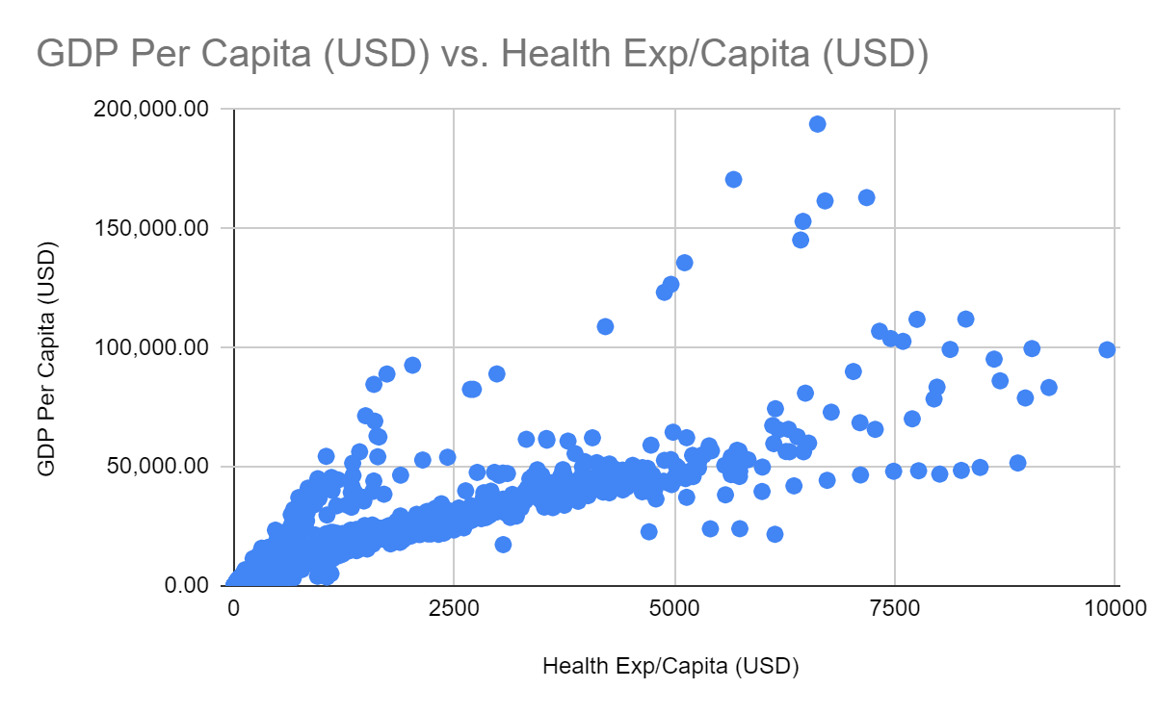
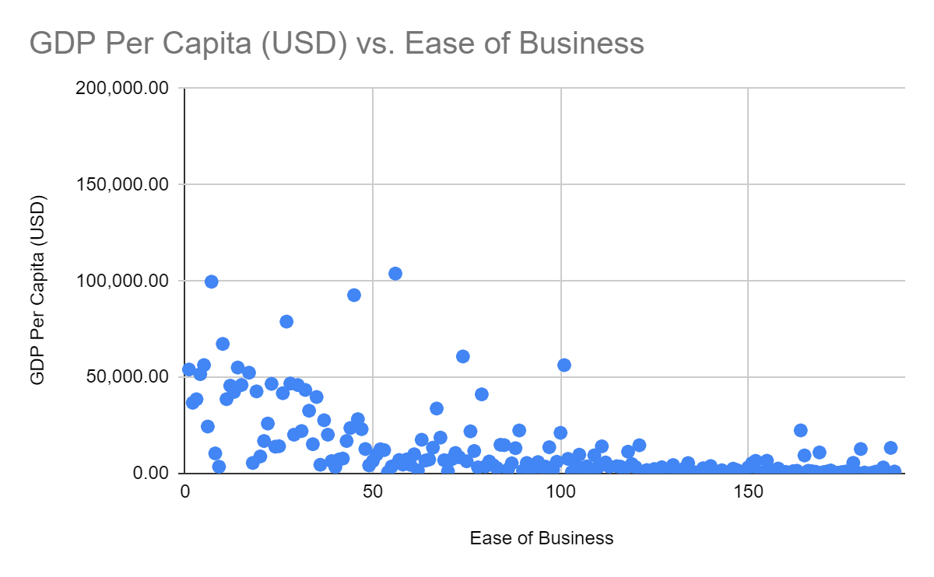
Annexure
Factors Affecting the Sustainable growth of a country
Health Expenditure Per Capita increases with increase
in GDP Per Capita
Countries doing well in the Ease of doing business ranking
also does well in economic growth

